Slide 1
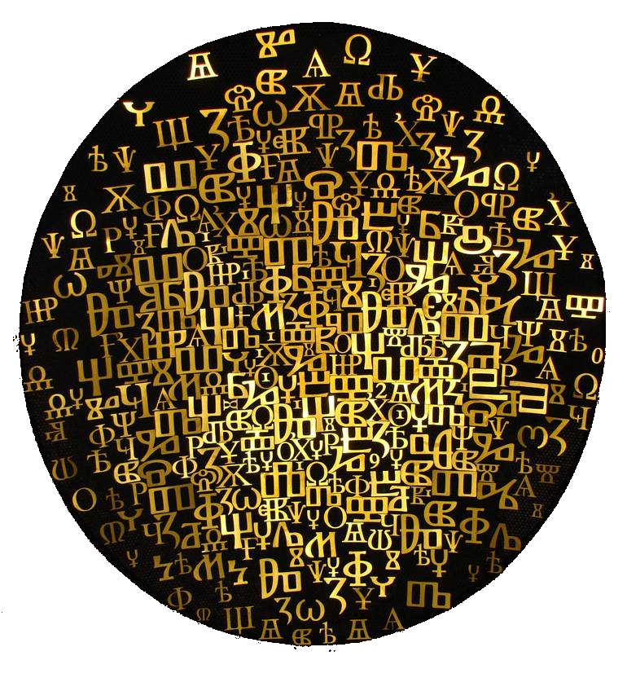
Glagolitic alphabet

Slide 2
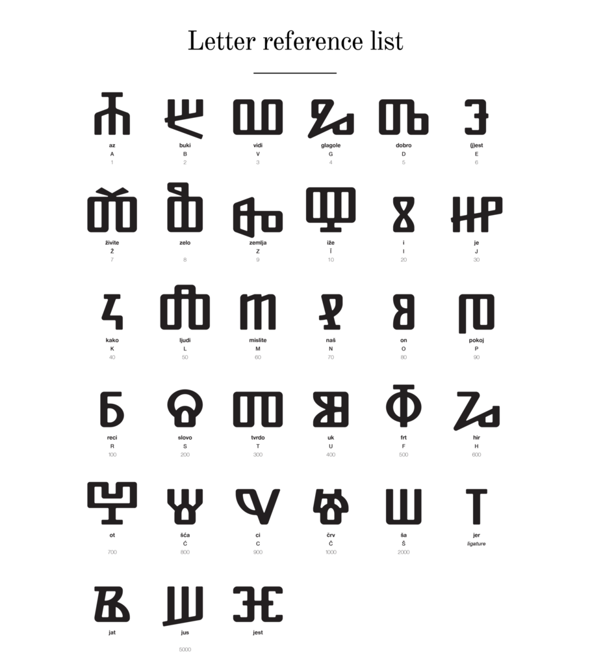
The Glagolitic script
The Glagolitic script, also known as Glagolitsa and Azbuka, is the oldest known Slavic alphabet originated in the middle of the 9th century and Croats used it over a thousand years.

Slide 3
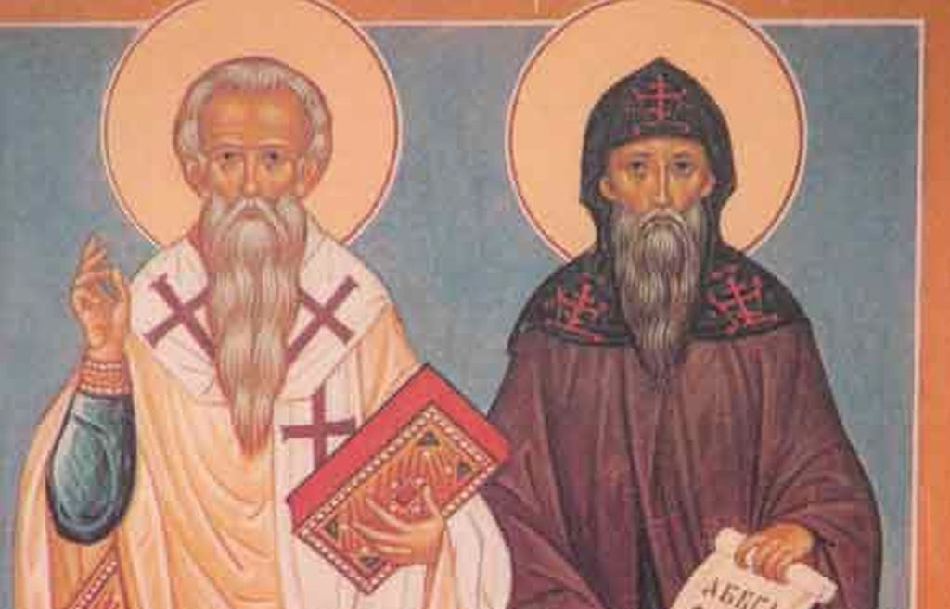
The Cyril and Method brothers
Saint Cyril Constantine and his brother Saint Methodius, were sent to spread Christianity among the West Slavs in the area.
The brothers decided to translate liturgical books into the then current Slavic language understandable to the general population (now known as Old Slavic language).

Slide 4
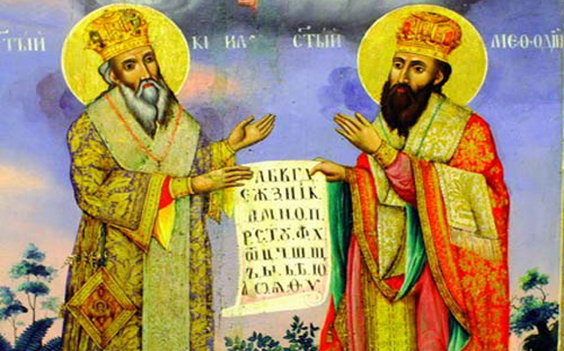
Who is the author of the Glagolitic alphabet?
The author of Glagolitic alphabet is Saint Cyril.
He invited Glagolitic script because the words of Old Slavic language could not be easily written by using either the Greek or Latin alphabets.

Slide 5
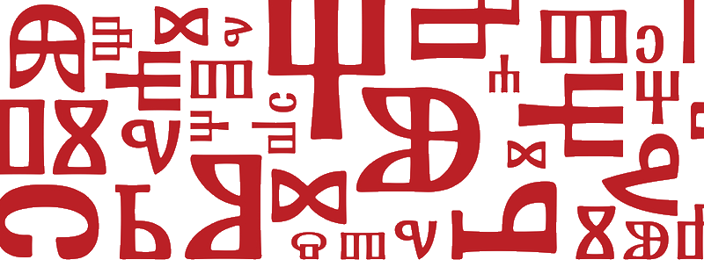
The Glagolitic alphabet had been used for centuries in this area and Croats considered it to be their alphabet until it was displaced by the, more widely used, Latin alphabet.
In Croatia, Glagolitic language was held until the 19th century.

Slide 6
Curiosities about the glagolitic alphabet
Glagolitic alphabet does not start like most of the Latin alphabets with the letters:
A B C
Instead, it starts with:
A B V G

Slide 7
Curiosities about the glagolitic alphabet
Every letter has its NAME in order to memorize the letters in an easier way.
The letter A is pronounced as „az“, and B as „buki“...
AZ + BUKI = AZBUKI
(Croatian: AZBUKA)

Slide 8
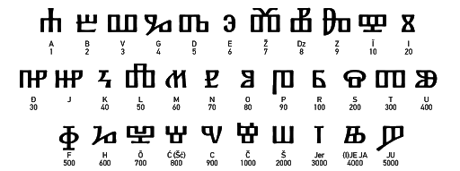
Curiosities about the glagolitic alphabet
Glagolitic alphabet did not have special signs for numbers, but it used the same signs for letters and numbers.

Slide 9
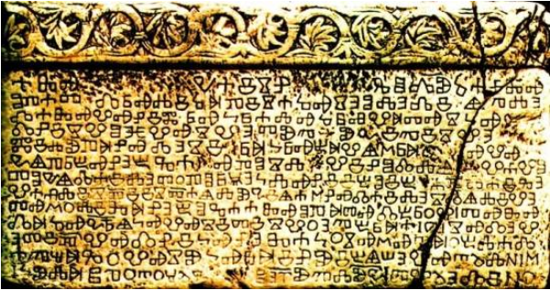
Baška’s Glagolitic Tablet
The Baška tablet dates back to 1100, it was discovered back in 1851, and in 1934 it was moved to Zagreb in order to conserve and preserve it for the future.
The Baška tablet is the first document of Croatian statehood to be engraved in stone with the Glagolitic alphabet. It proves the ancient existence of a civilised Croatian state in a period when a number of European states did not exist.

Slide 10
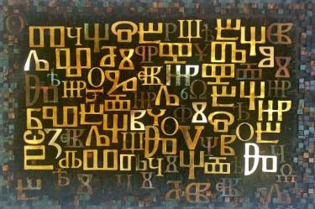
Conclusion
The Glagolitic script, as well as Glagolitic tradition, is a Croatian cultural phenomenon unique for its linguistic, graphic, ethnological, anthropological and semiotic characteristics.
In 2014, following the decision of the Ministry of Culture, the Glagolitic script was inscribed into the list of intangible cultural heritage of the Republic of Croatia.

